Slide 1
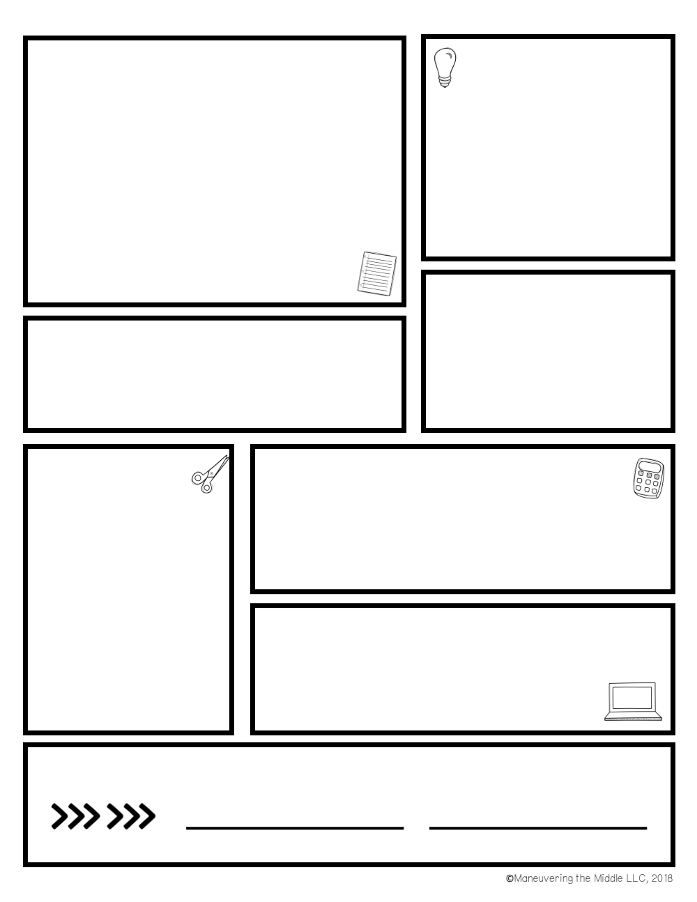
Expectations
Tutoring schedule
Respect is a MUST!
Be on time for class with all materials and ready to learn
Be Safe (no running or horseplay in the classroom)
No working on work for other subjects during class
Homework/classwork is expected to be completed on time
Late work will be accepted up to the test for the unit with a 10% penalty for being late; any work turned in past that will earn a maximum grade of 65%
Any work not turned in will receive a zero (3 reminders will be given to turn it in)
ID’s must be worn and visible at all times
No Agenda + No ID = NO PASS
No Cellular devices (keep them in your locker)
Before school 7:15 daily
Wednesdays 3:30–4:30 PM (WebEx)
Contact
Prep: 1st Hour: 7:51
(586) 825-2620 xt 24305
E-mail: rpregano@wcskids.net
Mrs. Pregano’s 6th & 8th Grade Social Studies
Supply List
WCS Board approved grading policy:
75% Assessments (test, quiz, project)
25% Classwork/Participation
Student ID
Student Agenda
Appropriate textbook
Pen/Pencil (blue or black ink only, please)
Paper (notebook)
Pocket Folder
Completed assignment(s)
A positive attitude!!
grading
Class website
mrsfisettesclass.weebly.com
WebEx Personal Room
wcskids.webex.com/meet/rpregano
Sign here
Parent signature
student signature

